Slide 1
Access Control & Firewalls
Unit Linux, Day 3
Cybersecurity Boot Camp |

Slide 2
Today’s Goals
By the end of class, you will be able to:
Develop firewall policies
Implement firewall rules with ufw
Interpret iptables rules
Write and interpret Snort IDS rules
Notes:
But today, we’re going to… Review goals, address questions.

Slide 3
Re/Overview
Firewalls control access to/ from a networked machine
ufw control access to specific ports
iptables allow systems to control exactly which packets are allowed into, out of, or through the computer
We’ll be transitioning from protecting the host from local exploitation to protecting the host from remote attacks

Slide 4
Blocking a Host and Testing Access Controls

Slide 5
Blocking a Host and Testing Access Controls
Let’s get started with some review exercises:
monitor traffic with tcpdump
use ufw to block traffic observed in tcpdump
Next, you’ll implement firewall rules that prevent an HTTP brute force attack

Slide 6
Blocking a Host and Access Controls (20 mins))
In this activity, you will (1.) use Wireshark to monitor traffic and (2.) use `ufw` to black web traffic to/ from the VM.
Web Traffic Pt 1
- Launch Wireshark. Use a capture filter to trace only HTTP traffic, then start sniffing packets.
- Open Firefox, and begin browsing the web. Navigate wherever you'd like, but make sure you browse to one of the below at least once:
- http://collegehumor.com
- http://example.com
- Return to your packet capture, and verify that you've caught at least some of your browsing traffic.
- Stop the capture, then launch a Terminal.
- Enable UFW, turn on logging, and run ufw status to verify that these commands worked.
- Configure UFW to deny all incoming and outgoing HTTP traffic.
Note: Use the port number, not the protocol name.
Verify your firewall rules.
Note: Use status verbose.
Launch Wireshark, and begin capturing HTTP traffic.
Launch Firefox, and begin browsing the web. Again, try browsing to one of the two sites below.
- http://collegehumor.com
- http://example.com
Check your Wireshark capture, and make sure it syncs up with your browsing experience.
(Part 2 on Next Slide →)

Slide 7
Activity: Blocking a Host & Access Control (20 min)
Web Traffic Pt 2
- Launch a Terminal.
- Use UFW to block HTTPS traffic to and from your machine.
Note: Use the port number, not the protocol name.
- Use Wireshark to capture HTTPS traffic, then attempt to browse the web.
- Check your Wireshark capture, and make sure it syncs up with your browsing experience.
- Run: ls /var/log/ufw*. This should list all log files generated by UFW. Read the first log file, and answer the questions below.
- What kind of packets does UFW log?
- Look for logs related to your attempts to browse to collegehumor.com and/or example.com.
Reinforcement
- After blocking HTTP traffic, you probably noticed you were still able to browse to several sites, but not to collegehumor.com or example.com. Explain why.

Slide 8
Review Access Control
Instructor Review

Slide 9
Today’s Goals
By the end of class, you will be able to:
✓ Develop firewall policies
Implement firewall rules with ufw
Interpret iptables rules
Write and interpret Snort IDS rules
Notes:
But today, we’re going to… Review goals, address questions.

Slide 10
Developing Policies with UFW

Slide 11
Firewall Design Principles
When configuring a new firewall, start from scratch.
A well-configured firewall should drop packets by default, only allowing access or egress if it's been explicitly enabled for a particular port and/or protocol.
Drop Incoming: ufw default deny incoming
Drop Outgoing: ufw default deny outgoing

Slide 12
Setting and Testing Firewall Rules (30 min)
In the activity, you will implement a firewall policy by setting rules with ufw. Specifically, you will:
Audit the services each machine furnishes
Determine which ports should be exposed
Design and document a firewall policy for each machine
Implement the policy on each machine
Instructions on next two slides →

Slide 13
Setting and Testing Firewall Rules
Auditing: review the list below, and fill out the blanks.
Service-Level Agreements for Supercorp's Intranet
User Data API
Description: Web server that provides access to organization's IAM database. This machine runs an HTTP and HTTPS server, which should be available to all machines on the subnet. There is also an SSH listener, which should only allow access from the command server. Disable connections to all other running services.
Service(s): _____To-do_______
Port(s): _____To-do_______
User Database
Description: MySQL server containing user data for IAM policies. Should only be accessible by the User Data API erver.
Service(s): _____To-do_______
Port(s): _____To-do_______
Command Server
Description: Server responsible for controlling whether other servers on the network are up or down. Allows administrators to log in remotely to issue commands. Block all requests to the telnet server that do not come from the local subnet. Allow outgoing SSH and telnet connections to other machines within the subnet.
Service(s): _____To-do_______
Port(s): _____To-do_______

Slide 14
Implementing Access Controls: refer to these UFW documents:
Common Firewall Rules and Commands: https://www.digitalocean.com/community/tutorials/ufw-essentials-common-firewall-rules-and-commands
How to Setup a Firewall with UFW: https://www.digitalocean.com/community/tutorials/how-to-setup-a-firewall-with-ufw-on-an-ubuntu-and-debian-cloud-server
- Begin by attaching to the scanner and using NMap to port-scan the subnet. All running services should expose ports. Save the results in /tmp/start_profile.benchmark.
Hint: Recall that you can save command-line output to a file with {command to run} > {file to save to}.
Next, implement the policy above by attaching to each machine and using ufw to set the appropriate rules on each machine. For each, do the following:
Enable UFW.
How is "enabling" different from "starting"?
Set a default rule to deny all incoming and outgoing traffic.
On each machine, create rules exposing the ports you identified above.
Note: You should allow both incoming and outgoing connections to each port.
Save each machine's configuration in a file called: /tmp/<machine_name>.policy.
- Generating Documentation
Finally, create and move into a directory called Policies, and copy over the policy files and benchmark you created.

Slide 15
Review Setting and Testing Firewall Rules
Instructor Review

Slide 16
Today’s Goals
By the end of class, you will be able to:
✓ Develop firewall policies
✓ Implement firewall rules with ufw
Interpret iptables rules
Write and interpret Snort IDS rules
Notes:
But today, we’re going to… Review goals, address questions.

Slide 17
Introducing iptables

Slide 18
Iptables
Iptables are a standard firewall included in most Linux distributions.
How do iptables work?
It matches each packet that crosses the networking interface against a set of rules, then decides an action.

Slide 19
Iptables: Key Concepts
Rules:
Conditions under which a server should ACCEPT or DROP a network packet

Slide 20
Iptables: Key Concepts
Chain:
A series of rules that a firewall applies to network packets
For example: the INPUT chain contains rules for filtering incoming packets

Slide 21
Iptables: Key Concepts
Table:
A collection of chains that serve a related purpose
For example: the FILTER table contains
chains dedicated to sifting allowing/disallowing packets

Slide 22
Iptables: Key Concepts
Firewall policy:
The set of rules that a firewall uses to decide how to filter packets

Slide 23
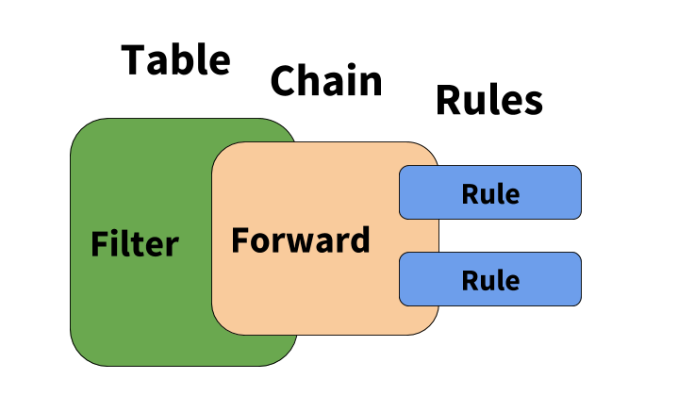
Tables, Chains, Rules

Slide 24
INPUT, OUTPUT, FORWARD
Iptables have three principle chains:
Input chains: determines whether the firewall accepts or drops incoming packets
Output chains: determines whether the firewall accepts or drops outbound connections
Forward chains: determines whether the firewall will act as a router and forward the packet to its destination.

Slide 25
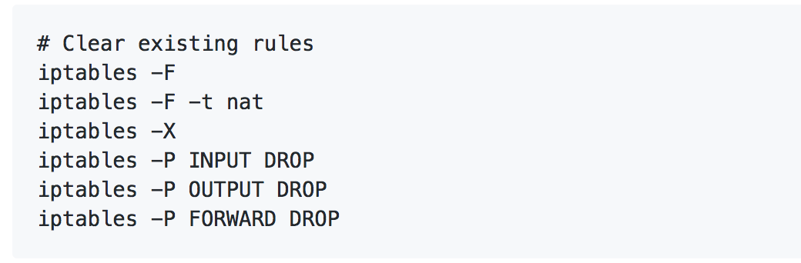
Activity: Interpreting iptables Rules (20 min)
In this activity, you will partner up and combine research with what you know about iptables to interpret common firewall rulesets, extracted from real configurations.
Flushing the T…able?
1. What do the manpages say about the -F flag?
2. What do the manpages say about the -t flag? What does nat represent in the second line of the above snippet?
3. What do the manpages say about about the -X flag?
4. What do the manpages say about about the -P flag?
5. Using the above, explain, in English, what the following lines from the configuration do:
iptables -F:
iptables -P INPUT DROP:
iptables -P OUTPUT DROP:
iptables -P FORWARD DROP:
Continue on Next Slide →

Slide 26
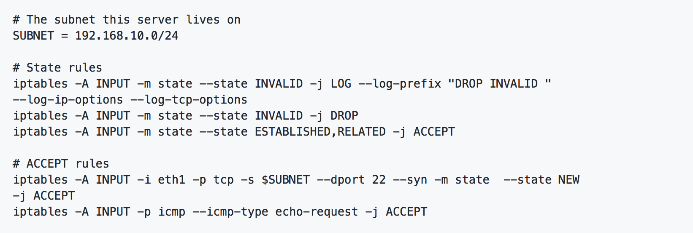
Activity: Interpreting iptables Rules (20 min)
INPUT Rules:
Review and research the above snippet, then answer to the questions your instructor sent in the Slack file.

Slide 27
Review Interpreting iptables Rules
Instructor Review

Slide 28
Continued Review
Why is the logging capability of iptables critical?
How would you modify the rule you just identified to protect the server?
Suppose the server from earlier had logging enabled with iptables. What steps might you take as an administrator after learning about the attack?

Slide 29
Today’s Goals
By the end of class, you will be able to:
✓ Develop firewall policies
✓ Implement firewall rules with ufw
✓ Interpret iptables rules
Write and interpret Snort IDS rules
Notes:
But today, we’re going to… Review goals, address questions.

Slide 30
Real iptables

Slide 31
Activity: Real iptables Rules (15 min)
In this activity, you will try your hand at interpreting iptables rules generated by UFW.
Instructions
Attach to each machine in the network, and save the iptables rules to /tmp/iptables.rules.
The command is: iptables -L > /tmp/<machine name>.iptables.rules, where <machine name> is, of course, the name of the specific machine you run the command on, e.g., command_server.iptables.rules.
Create a new directory, called rules. Copy each machine's rules file to this directory.
Inspect command_server.iptables.rules and answer the following:
How many rule entries are registered on the firewall?
Hint: Use wc -l.Where in the list do your rules appear?
2. You set two UFW rules on this server. How many iptables rules does this result in?
3. What is the difference between the different iptables rules generated by each UFW rule?
Inspect database.iptables.rules and answer the following:
Which subnet is allowed to connect to port 3306? How big is this subnet?
Inspect user_data_api.iptables.rules and answer the following:
How many simultaneous connections is a host allowed to make to this machine before the firewall drops new connection requests?
Which machines respond to ping probes?
Which machines have rate limiting?
Identify two rules you did not create that UFW instated for you.

Slide 32
Review Real iptables Rules
Instructor Review

Slide 33
Activity: Capture and Deny Rules (15 min)
In the activity, you will review the major takeaways from yesterday's lesson, including:
Packet Captures with tcpdump
Implement deny rules with ufw
Instructions:
Packet Captures with tcpdump
Refer to the tcpdump Primer: https://danielmiessler.com/study/tcpdump/
On the Workstation, move to /tmp.
Start a packet capture, and save it to the file mystery.pcap.
Note: Be sure to save the entire packet ("snaplength"), and listen on any interface.
Open the capture with Wireshark, and filter for tcp. Right-click on one of the TCP packets, and click Follow Stream.
Based on what you know about NMap, what kind of traffic is this?
Identify the IP Address of the attacking machine.
Access Control with UFW
Implement a deny rule with UFW that blocks all traffic from the offender.
List your firewall rules to ensure the rule was added, and use tcpdump to verify that it's in effect.

Slide 34
Review Capture and Deny Rules
Instructor Review

Slide 35
Today’s Goals
By the end of class, you will be able to:
✓ Develop firewall policies
✓ Implement firewall rules with ufw
✓ Interpret iptables rules
✓ Write and interpret Snort IDS rules
Notes:
But today, we’re going to… Review goals, address questions.

Slide 36
Fin

